Slide 1
London 2012 Olympic and Paralympic Games: Legacy
Andrew Honeyman
Head of Physical Activity and Olympic and Paralympic Legacy, Department for Culture, Media and Sport
Day Month Year Name job title

Slide 2
Legacy from London 2012
“I am delighted to see that our British partners have succeeded in maximising the legacy of London 2012 across a number of different areas…as IOC President, I see that London and Britain have also understood that the Games can be a catalyst for positive long-term economic, social and sustainable legacies” – Thomas Bach, President of the International Olympic Committee, July 2014

Slide 3
Headline Legacy Achievements
1.6 million more people playing sport once a week than when we won the bid in 2005
4-year target of £11bn economic benefits through trade and investment off the back of the Games achieved in just over one year. Latest figure is £14.2bn (July 2014)
All eight retained venues at Queen Elizabeth Olympic Park have a secured future in legacy. 4 million visitors to QEOP since it re-opened in 2013
Volunteering increased by 7% in 2012/13 following the boost from the Games, reversing steady decline since 2005. Increase maintained since
260,000 more disabled people playing sport once a week than in 2005.

Slide 4
Olympic and Paralympic Legacy
London
2012
Legacy
Sport and Healthy Living
Economic Growth
Communities
Regeneration of East London
Paralympic Legacy

Slide 5
Legacy achievements - sport
1.6 million more people playing sport than in 2005
£1bn investment in grassroots sport over 4 years
£150m a year for three years for primary school sport and PE – to continue to 2020
Increased funding for elite sport through to Rio – 13% increase for Olympic athletes and 45% for Paralympians
Investing £27m to bid for and host more than 70 of the world’s most prestigious sporting events

Slide 6
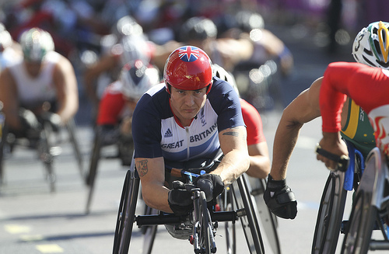

Slide 7
Legacy Achievements – Regeneration of East London
All eight retained venues on Queen Elizabeth Olympic Park have futures secured
Park fully open from summer 2014 – iconic Aquatics Centre and Velodrome already open for community use
School and Sir Ludwig Guttman Medical Centre open and people living in former Athletes’ Village
Huge range of events held in Park, including athletics and concerts summer 2013 and Sport Relief March 2014, Rugby World Cup autumn 2015, WHUFC August 2016
Plans for ‘Olympicopolis’ new higher educational and cultural district, destined to create up to 10,000 jobs and boost UK economy by £bns

Slide 8
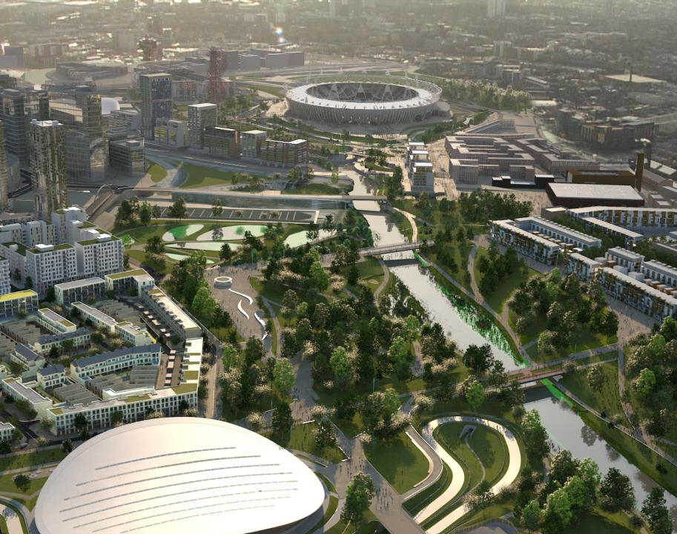

Slide 9
Legacy Achievements - Economic
Over £14bn of economic benefit through trade and investment won through Games and Games-time promotional activity
Inbound tourist numbers and spending have increased, with a record breaking 32.8m visits to the UK in 2013 and visitor spending of just over £21bn
Another first for London 2012: Supplier Recognition Scheme enabling UK companies that supplied the Games to promote this in business to business activity. 780+ companies have free licences
Meta-evaluation estimates economic impact up to 2020 as £28bn - £41bn in Gross Value Added and 618,000 to 893,000 years of employment
GREAT campaign to promote UK has delivered £600m of revenue to UK and used in 140 countries.

Slide 11
Legacy Achievements - Communities
Volunteering in England increased from 65% in 2010/11 to 72% in 2012/13, reversing steady decline since 2005. Increase has been maintained since
Team London Ambassadors (London Games-time volunteers) used since for major events, visitor welcome and in schools
Join In established as independent charity to be ‘home of the Games Maker’ getting GMs and their spirit into community sport - over 11,000 Join In events in 2013 with 100,000 new volunteers recruited for community sport
Spirit of 2012 established as independent charity to allocate £40m funding from sale of Olympic Village : Investing in Happiness!
Cultural Olympiad reported huge public engagement, estimated at 43.4m people at events

Slide 13
Legacy Achievements - Paralympic
260,000 more disabled people playing sport once a week than in 2005
53% of people said that the Paralympics had a positive impact on the way they see disabled people
£150m invested in disability sport by Sport England
Stoke Mandeville recognised as permanent home of Paralympic Movement with permanent role in future Paralympic flame lighting ceremonies, including 1 March last year for Sochi
Government/Mayor of London project working with institutions to include accessibility for disabled people as part of the core curriculum for all built environment professionals

Slide 14
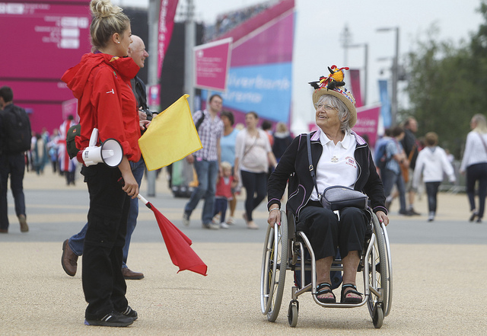

Slide 15
Moving more, Living more
Legacy project aiming at increasing physical activity
Launched February 2014 by Lord Coe, Ministers, Chair of Local Government Association, Jennie Price (Sport England)
Focus on much better joined up working within government and beyond
Commitment to sustained, strategic and long-lasting action
Commitment to targeting least active and disadvantaged groups and shining a light on existing good practice
Lord Coe: ‘A joined up approach to challenging inactivity and encouraging physical activity is key. Moving More, Living More will bring together government, local government, business and above all the individuals and community groups - who know how to get people moving.’

Slide 16
National ambition
‘To have a year on year increase in the number of adults doing 150 minutes of exercise per week (in bouts of 10 minutes or more) and a year on year decrease in those who are inactive, defined as doing less than 30 minutes of exercise per week (in bouts of 10 minutes or more). ‘

Slide 17
MMLM activity
Public Health England published ‘Everybody Active Every Day’ framework in October 2014. Report with options for action backed by extensive research. Regional seminars with ukactive and others before and after publication
Department for Transport work on cycling and walking led to provision in Infrastructure Act for Cycling and Walking Investment Strategy
Cross-government ministerial group and underpinning officials’ group

Slide 18
Outdoor recreation
Stakeholders, led by Sport and Recreation Alliance and the Outdoor Industries Association called for a government-wide strategy to promote outdoor recreation
Minister for Sport and Tourism asked SRA and OIA to submit proposals on possible strategy
Proposals to come to government in September
New minister also supportive of this work – a number of departments with an interest.

Slide 19
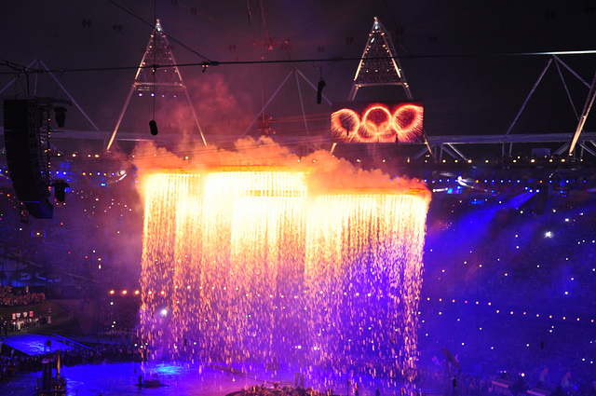

Slide 20
Any questions?
Andrew Honeyman
Head of Physical Activity and Olympic and Paralympic Legacy
Department for Culture, Media and Sport
Andrew.honeyman@culture.gov.uk

