Slide 1
Creating outdoor recreation's own legacy
Emma Boggis
Chief Executive
Sport and Recreation Alliance

Slide 2
Overview
Introduction to the Sport and Recreation Alliance
Olympic/Paralympic legacy for outdoor recreation
The bigger picture
Looking to the future and steps towards creating outdoor recreation’s own legacy
Notes:
Pleased to be here etc.
Introduction to the Alliance, most delegates should know who we are but worth a quick bit of background. Also include how we’re linked to the ORN.
Will respond to Andrew’s presentation and speak a little bit about the Olympic/Paralympic legacy for outdoor recreation as it stands
Will also take a bit of time to look at the bigger picture and other ways in which outdoor recreation is growing
Want to take this opportunity to look to the future and where outdoor recreation fits in with the external environment – part of this is how we ensure the sector is Fit for the Future
End with steps towards creating outdoor recreation’s own legacy which will lead into the workshop discussion

Slide 3
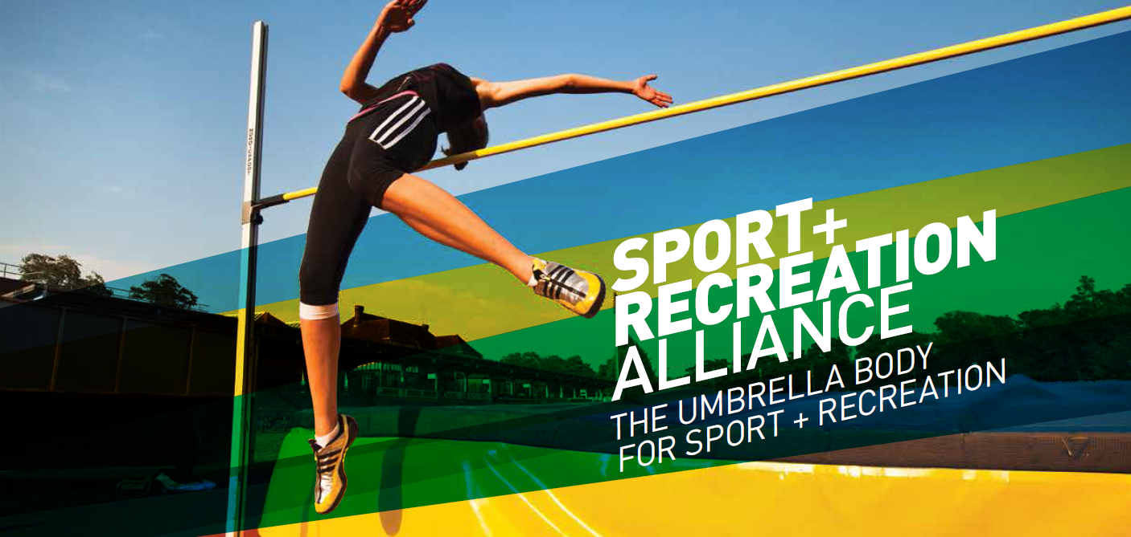
About the Sport and Recreation Alliance…
Notes:
We are the umbrella organisation for the governing and representative bodies of sport and recreation in the UK
320 members
Our role is to speak up on behalf of our members, represent their views and to provide them with services which make their life easier
We are members of the Outdoor Recreation Network and are keen to work together to share good practice and information, influence policy and political developments and bring the voices of our memberships together.

Slide 4
Olympic/Paralympic legacy
Facilities created new opportunities to access outdoor recreation
Regeneration of Olympic Park:
more than four million visits to the Park since July 2013
covers 560 acres which includes 6.5km of waterways and 15 acres of woods, hedgerow and wildlife habitat
4 free themed walking trails – London 2012, Biodiversity, Art in the Park and Kids’ activity
Notes:
Start with a few points to build on what Andrew has said around the Olympic and Paralympic legacy to date:
Olympics/Paralympics created new facilities that allow access to outdoor recreation such as the Weymouth and Portland National Sailing Academy
Regeneration of the Olympic Park – statistics from the Olympic Park website

Slide 5
Olympic/Paralympic legacy
Raised awareness of outdoor activities and potential link to increased participation (APS):
Over 3.8 million people are cycling – increase of 300,000
Over 200,000 people are mountaineering – increase of over 30,000
Over 192,000 people are rowing – increase of nearly 24,000
Over 123,000 canoeing – increase of over 17,000
MENE also tells us that:
Around nine in ten members of the English adult population visited the outdoors at least once in the last 12 months
Walking was by far the most frequently undertaken activity
Notes:
Stats taken from Active People’s Survey 9 published yesterday – data for 16+ once a month
Comparison figures are against APS 1 (Oct 2006– Oct 2007)
Second set of stats taken from Natural England’s 2013/14 Monitoring Engagement with the Natural Environment (MENE) survey

Slide 6
The bigger picture – Reconomics
A literature review of existing evidence
Pulling together what we know and putting it in one place
Bringing data to life with case studies
Partnership approach
Liverpool John Moores University
Outdoor Industry Association
Natural England
Visit England, Sport England, ONS
Our members
Notes:
Also worth thinking about the bigger picture – Reconomics helps with this by setting out the economic value of outdoor recreation. Reconomics……

Slide 7
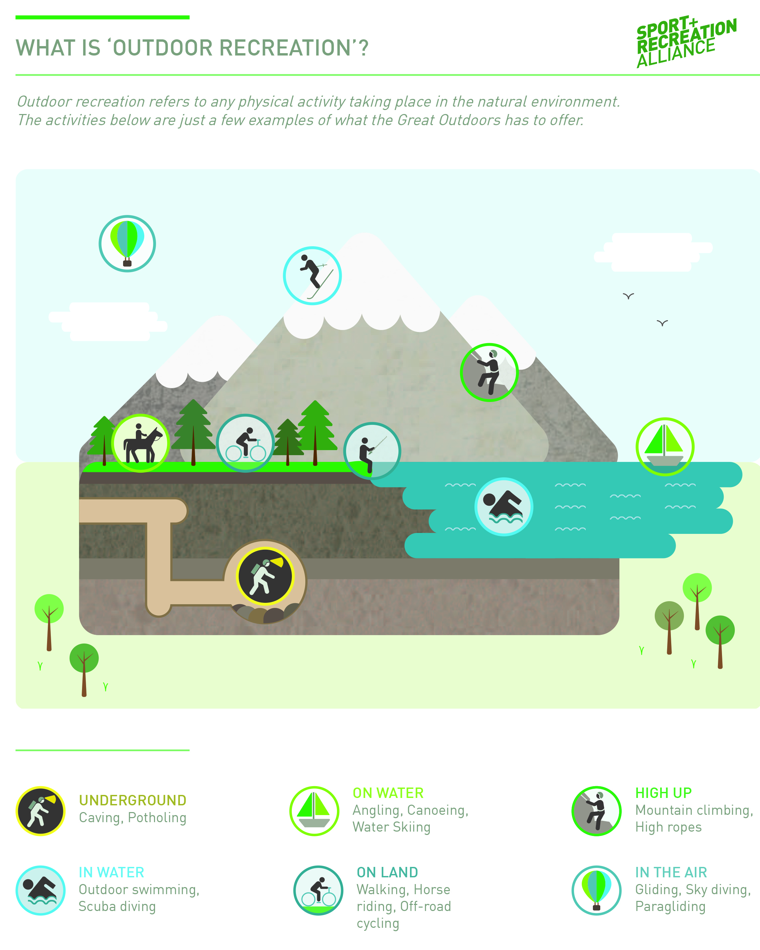
Notes:
Reconomics provides a definition of outdoor recreation……

Slide 8
Notes:
Reconomics shows that outdoor recreation is incredibly popular and therefore has great potential

Slide 9
We also found…
Outdoor recreation is good for both mind and body
Getting active outdoors is associated with:
lower levels of stress, tension and depression
Increased self-esteem and energy levels
Added enjoyment of being outdoors can encourage us to be more active more regularly
Outdoors offers communities a valuable social space and can alleviate social isolation

Slide 10
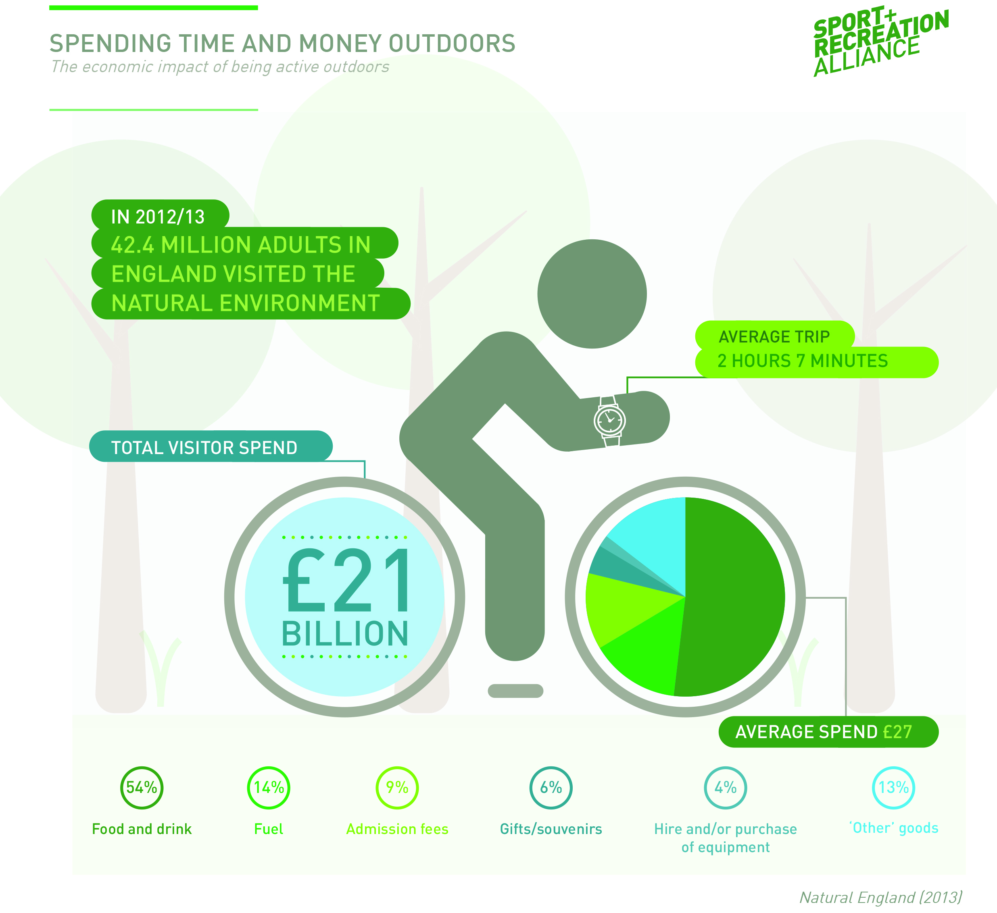

Slide 11
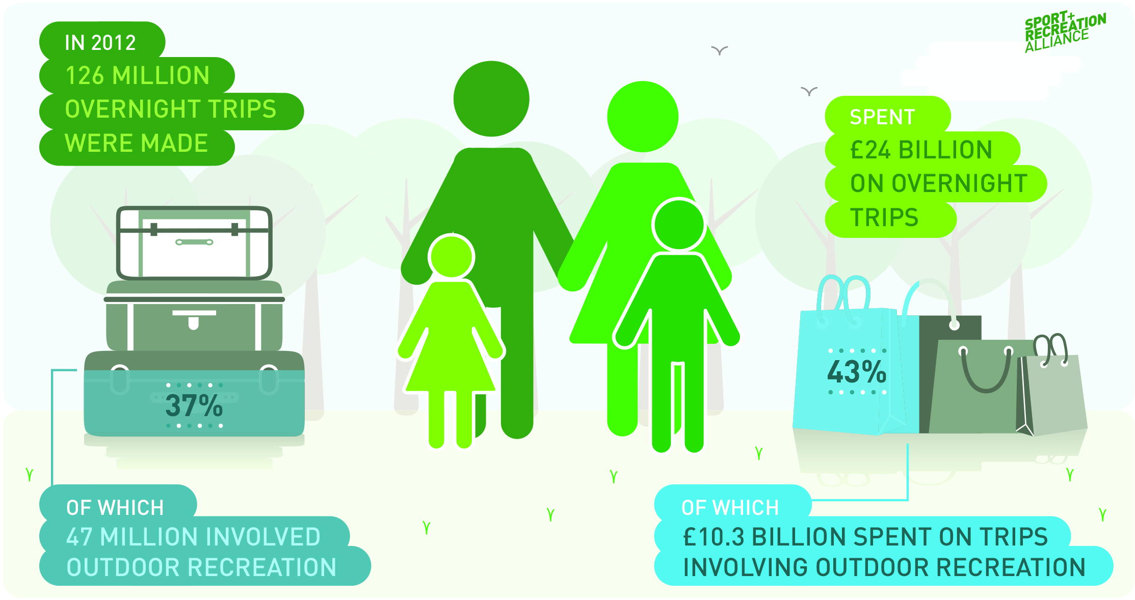

Slide 12
Case Studies
From the national…
…to the local

Slide 13
Impact
Referenced in various Parliamentary debates including Westminster Hall debate on outdoor recreation
Minister made a commitment to consider a national outdoor recreation strategy
Used by the sector to demonstrate its value
Referenced in submissions, including Culture, Media and Sport Committee tourism inquiry and Health Committee physical activity inquiry

Slide 14
The bigger picture
Legacy of other major events such as Tour de Yorkshire, Commonwealth Games in Glasgow?
Volunteers:
are the stewards of the natural environment and ambassadors for the outdoors
Brings more opportunities but also skills, knowledge and confidence for the volunteers themselves
Younger people are particular beneficiaries of the employment and volunteering opportunities within the outdoor recreation network
A high proportion of work in the sector is seasonal, and offers many young people their first taste of working life
Notes:
Also worth thinking about the bigger picture:
Other major events that have followed the Olympics although impact of these are yet to be seen
Outdoor recreation’s contribution to the tourism economy
Legacy could potentially have inspired volunteers - Join In’s estimate is that sport volunteering is worth £53bn – one of the most valuable sectors in the UK, on a par with the energy sector and four times bigger than agriculture – outdoor recreation also relies on its workforce and volunteers are a key part of this.
Reconomics highlights the benefits of volunteering for the wider population but also the volunteers themselves – increased knowledge, confidence and competencies

Slide 15
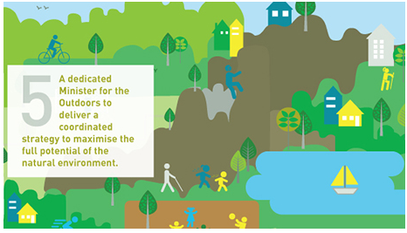
Looking to the future
Notes:
Outdoor recreation is central to our five-step plan for a more active population. Ask five focuses on the outdoors – a dedicated Minister and a national strategy for outdoor recreation in England.
We, along with many of our members, had positive conversations with Helen Grant when she was Minister for Sport and Tourism about a national outdoor recreation strategy for England. This led to a cross-departmental roundtable and the Alliance and Outdoor Industries Network being asked by DCMS to consult with the sector on what could be included in such a strategy. We’ll talk about this further in the workshop.
We’re looking to continue this work following the election. Tracey Crouch spoke positively about outdoor recreation at our Sports Summit last week and earlier this week I met Tracey and she said………………………..
Although DCMS is currently taking a lead on an outdoor recreation strategy, we’re clear that this needs to be cross-departmental and will be engaging DH, Defra and DfT in our conversations too.

Slide 16
Looking to the future
Opportunity to create outdoor recreation's own legacy across the UK:
Health
Economy
Education
Shaping the natural landscape and regeneration
Commercialism
and markets
Notes:
We now have the chance to create outdoor recreation’s own legacy across the UK:
As mentioned we’re working with the sector and government on proposals around a national outdoor recreation strategy for England. We hope this can build on learning from the Northern Ireland outdoor action plan and I look forward to hearing from Mike (McLure – Sport Northern Ireland) about his experience of developing the action plan and thoughts around implementation in the workshop
More broadly there are areas that outdoor recreation can engage better with and become more prominent within:
Health – public and mental health
Economy – preventative savings to health as well as generating income through tourism
Education – outdoor learning becoming central to children’s education and making an impact on the next generation
Shaping the natural landscape and regeneration – e.g. the coastal path and regeneration of brown field sites
Commercialism and markets – will come on to this in more detail

Slide 17
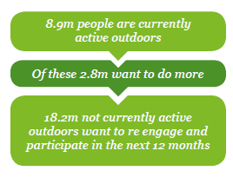
Looking to the future – The outdoor market
Notes:
Specifically on commercialism and markets - Sport England commissioned the OIA to research the outdoor market. The research looks at the market, its scale, its stakeholders, the trends and opportunities and examines what motivates people to be active in the outdoors and how provision can be mapped against participation to identify gaps and opportunities.
First time a thorough examination of outdoor providers has taken place. Thought there was around 2,500 but found there to be over 9,000.

Slide 18
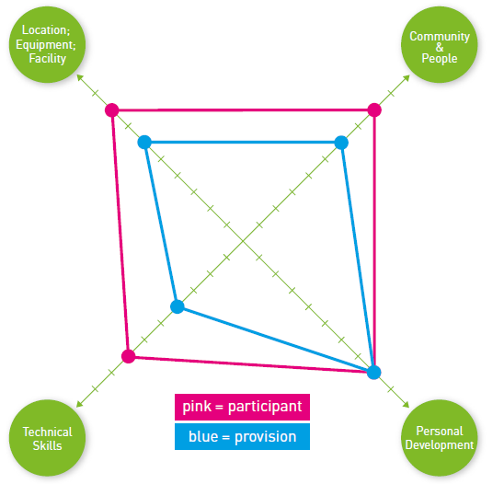
Looking to the future – The outdoor market
Notes:
The research looks at participants in outdoor activity and the experience they desire. It provides tools to profile what is delivered and how it is delivered. These profiles can be compared to the motivational requirements of the users to see how well the demand is supplied.

Slide 19
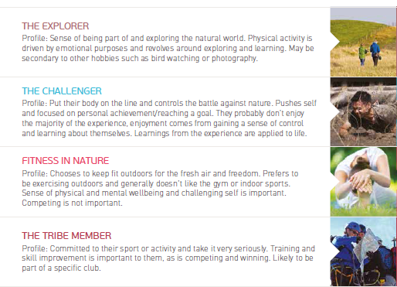
Looking to the future – The outdoor market
Notes:
The research covers the motivations for accessing outdoors activity, all of which vary across ages and life stages.
It found 8 participant segment groups. Some people may fit into a different segment depending on what they are doing or may have the same motivation for a range of activities.
This shows the broad range of reasons people engage and the opportunity to maximise participation through gateway activities and working together.

Slide 20
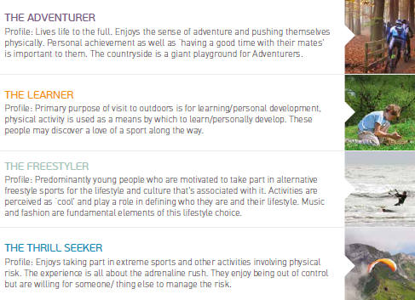
Looking to the future – The outdoor market

Slide 21
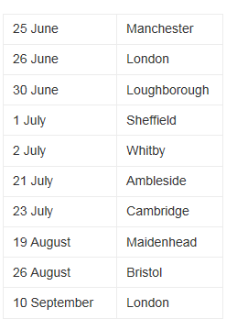
Looking to the future – The outdoor market
Sport England and the OIA are running workshops on the research and how organisations can use it to respond to the market and maximise the potential of outdoor recreation.
To book email: bookings@theoia.co.uk.

Slide 22
Steps towards a new legacy
New Government = new opportunity to put outdoor recreation on the map across departments
A national strategy for outdoor recreation in England?:
June – review existing strategies and online consultation with the sector
July – face-to-face consultation and prioritisation sessions
August – report writing
September – submit report to DCMS
Notes:
We have a great opportunity to work together and create outdoor recreation’s own legacy:
The Alliance will work with partners, including the ORN, to influence Government to give outdoor recreation the profile and commitment it deserves
As mentioned we’ve been asked by DCMS to ask the sector what should be included in a national outdoor recreation strategy for England. Over the coming months we will be engaging with the sector, we will then bring all the findings together in a report for Government which we hope will provide a robust basis for a strategy

Slide 23
Steps towards a new legacy
Build the evidence base across the UK to demonstrate value of outdoor recreation
Work together to open opportunities for participation in outdoor recreation to all
Notes:
We have a great opportunity to work together and create outdoor recreation’s own legacy:
We need to work together to build the evidence for outdoor recreation. Reconomics is a great start but we also need to demonstrate the impact of projects and programmes on individuals and society. Last week Dr Justin Varney spoke at our Sports Summit and encouraged the sector to think about how it evidences the impact of physical activity on people’s health – this is something we can improve
The Alliance’s membership is incredible broad and we’re keen to facilitate joint-working to increase opportunities for everyone to engage with and have fun in the outdoors. We know that many outdoor activities are gateways to others, with participants moving around activities depending on the weather, time of year or just what they feel like doing. So we need to maximise this and embrace its diversity for the benefit of all

Slide 24
Questions?

Slide 25
Workshop

Slide 26
A national outdoor recreation strategy?
1. The following themes have been suggested as a helpful framework for a national outdoor recreation strategy based on work already done within the sector:
The outdoors helps people be happy and healthy
The outdoors helps children and young people achieve their potential
The outdoors contributes to the national economy
The outdoors demonstrates its economic and social value
The outdoors is accessible to everyone
The outdoors is protected
Under these themes, what do you think are the issues that could be addressed in a national strategy?
Feel free to add your own theme if it isn’t covered by the above.
Notes:
As mentioned we, along with the OIA, have been asked by DCMS to consult with the sector on what should be included in a national outdoor recreation strategy for England. We hope that you will have seen information about this but if not this is your opportunity to feed into the consultation.
We’re looking for realistic, achievable recommendations and are keen to hear your thoughts. I know that some of you are not based in England but hope you can get involved in this workshop through sharing learning from your own experiences and also perhaps principles which could feature in an England strategy but be adopted across the nations.

Slide 27
A national outdoor recreation strategy?
2. For each issue, what would be your recommendation
for change?
E.g. Government should….
3. Out of all of the recommendations, what would be
your top 5?
Notes:
2. Write recommendations on a flip chart – Remember these need to be realistic, achievable etc. They can be England specific or suggest principles that could be adopted across the nations.
3. Dot vote – give people 5 sticky dots and ask them to put them next to the recommendations they think are most important, they can put more than one dot next to a recommendation if they think it’s incredibly important

